Slide 1
Introduction to DDL and DML

Slide 2
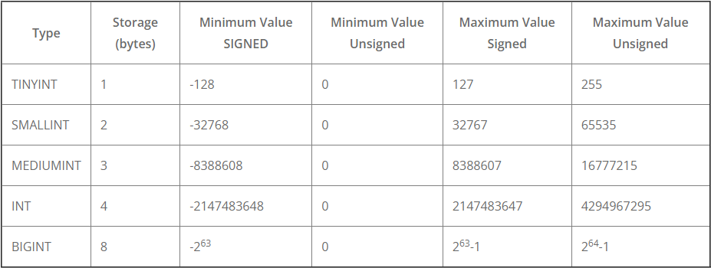
Numeric Data Types
INTEGER data types can be UNSIGNED and SIGNED.
UNSIGNED can store only zero and positive numbers in a column. If the values in the column never use negative numbers or when there is a need in using a larger upper numeric range for the column, you can set UNSIGNED
SIGNED can allow zero, positive, and negative numbers. With the MySQL value as SIGNED, one bit is taken for the sign symbol as opposed to the unsigned ones, when they do not have signs preceding the value.

Slide 3
Character Data Types
The CHAR and VARCHAR types are similar, but differ in the way they are stored and retrieved. They also differ in maximum length and in whether trailing spaces are retained.
The length of a CHAR column is fixed to the length that you declare when you create the table. The length can be any value from 0 to 255
The length of a VARCHAR column can be specified as a value from 0 to 65,535
VARCHAR values are not padded when they are stored

Slide 4
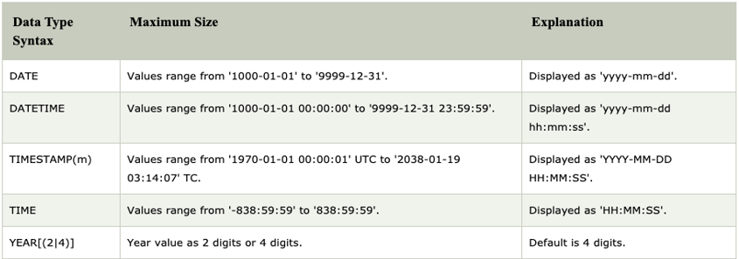
Date Data Types

Slide 5
Introduction to Data Definition Language
DDL or Data Definition Language consists of the SQL commands create database and modify the structure of table in the database
You create database to store tables by executing the SQL CREATE DATABASE statement
SYNTAX: CREATE DATABASE <db_name>;
Eg : Create Database Institute;
You create tables to store data by executing the SQL CREATE TABLE statement
SYNTAX
CREATE TABLE <table_name> (column datatype(SIZE)[, ...]);
Where we specify:
→The table name
→The column name, column data type, and column size

Slide 6
The below statement will CREATE a TABLE called STUDENTS.
CREATE TABLE STUDENTS
(
id int,
name varchar(20),
);
ALTER TABLE Statement
To change the structure of the table we use ALTER statement.
Use the ALTER TABLE statement to:
• Add a new column
• Modify an existing column definition
• Define a default value for the new column
• Drop a column
• Rename a column

Slide 7
ALTER TABLE <table_name> ADD
(<column_name> <column definition>
[<column_name> <column definition>]);
Eg: alter table students add mail_id varchar(33);
ALTER TABLE <table_name> MODIFY <column_name> <column definition>;
Eg: Alter table students modify mail_id char(22);
ALTER TABLE <table_name> DROP <column_name>;
Eg: alter table students drop mail_id;
ALTER TABLE <table_name> RENAME COLUMN <column_name>
Eg:alter table students rename sname to stud_name;

Slide 8
RENAME TABLE Statement
Rename table statement can change name of one or more tables.
RENAME TABLE tbl_name TO new_tbl_1
Eg: RENAME TABLE demo to new_demo;
DROP TABLE Statement
Drop table removes one or more tables from database.
DROP TABLE tbl_name ;
Eg:drop table new_demo;

Slide 9
TRUNCATE Statement
→Removes all rows from a table, leaving the table empty and the table structure intact.
→Is a data definition language (DDL) statement rather than a DML statement; cannot be undone.
TRUNCATE TABLE <table_name>;
Eg:truncate table students;

Slide 10
Managing Tables Using DML Statements
A DML statement is executed when you:
– Add new rows to a table
– Modify existing rows in a table
– Remove existing rows from a table
A transaction consists of a collection of DML statements that form a logical unit of work.
INSERT Statement
→Add new rows to a table by using the INSERT statement:
INSERT INTO table [(column [, column...])] VALUES (value [, value...]);
→With this syntax, only one row is inserted at a time.

Slide 11
UPDATE Statement
→Modify existing values in a table with the UPDATE statement:
UPDATE table
SET column = value [, column = value, ...]
[WHERE condition];
→Update more than one row at a time (if required).
DELETE Statement
You can remove existing rows from a table by using the DELETE statement:
DELETE [FROM] table [WHERE condition];

Slide 12
TCL Commands
COMMIT
COMMIT command in SQL is used to save all the transaction-related changes permanently to the disk.
Autocommit is by default enabled in MySQL. To turn it off, we will set the value of autocommit as 0.
SET autocommit = 0;
SAVEPOINT
Using the SAVEPOINT command in SQL, we can save these different parts of the same transaction using different names
.

Slide 13
ROLLBACK
we have an option of rolling back our transaction.
SET AUTOCOMMIT=0
0==>DISABLE
1==>ENABLE
CASE1>AUTOCOMMIT IS ENABLED
DELETE FROM EMP;-->ALL THE ROWS WILL BE DELETED
ROLLBACK; (ROWS WILL NOT BE BACK)
TRUNCATE TABLE EMP;--->ALL THE ROWS WILL BE DELETED.
(ROWS WILL NOT BE BACK)
CASE 2>AUTOCOMMIT IS DISABLED
DELETE FROM EMP;-->ALL THE ROWS WILL BE DELETED
ROLLBACK;
(ROWS WILL BE BACK)
TRUNCATE TABLE EMP;--->ALL THE ROWS WILL BE DELETED.
ROLLBACK;(ROWS WILL NOT BE BACK)

Slide 14
Including Constraints
Constraints enforce rules at the table level.
Constraints ensure the consistency and integrity of the database.
The following constraint types are valid:
NOT NULL
UNIQUE
PRIMARY KEY
FOREIGN KEY
CHECK

Slide 15
NOT NULL: The NOT NULL constraint ensures that the column contains no null values
UNIQUE:A UNIQUE key integrity constraint requires that every value in a column be unique
PRIMARY KEY:A PRIMARY KEY constraint creates a primary key for the table. Only one primary key can be created for each table.
FOREIGN KEY :The FOREIGN KEY (or referential integrity) constraint designates a column or a combination of columns as a foreign key, and establishes a relationship with a primary key or a unique key in the same table or a different table.
Referential Actions
ON DELETE CASCADE : Delete the row from the parent table and Deletes the foreign key row in the child table.
ON UPDATE CASCADE tells the database that when an update occurs on the referenced column from the parent table, it must automatically update the matching rows in the child table with the new value.
CHECK : The CHECK constraint defines a condition that each row must satisfy.

